Slide 1
Southern California Edison Proposal Distribution Group Study Process Workshop June 6, 2012

Slide 2
Proposal for Distribution Group Studies
General
SCE proposes a Distribution Group Study (DGS) process that will be flexible enough to allow group study when several transmission independent projects are submitted in the same electrical area at around the same time
This is a draft proposal and is subject to change
Applicability
All projects that pass transmission system independence (screen Q) and fail distribution system independence (screen R)
The DGS process is designed for projects that are not transmission interdependent, but are interacting with other queued projects on the distribution system (e.g. a project undergoing an ISP).
The DGS is mandatory for projects that pass Screen Q and fail screen R, unless Applicant withdraws
A single developer with multiple applications in one area submitted at the same time may request that the projects be studied in a DGS (i.e. waive screen R)
If the developer did not request a group study for its projects, the first project in the bunch would, potentially, pass Screen R and be studied under ISP and the remaining would fail Screen R and be studied as a DGS when the first project is complete.
A developer’s request to study multiple projects in a DGS does not create an exclusive distribution group i.e. other projects may be placed in the same group

Slide 3
Study Process
Study Process
The study itself will follow the Rule 21 ISP with an System Impact Study, results meeting, financial security posting and Facilities Study (if required)
The Rule 21 timelines for the studies and for applicant responses will apply.
However, if the volume of studies reaches a certain level and/or the number of applicants in a particular group study reaches a certain level, additional time will be required to complete studies and prepare interconnection agreements. There may be limits on how many applicants can be studied in one DSG.
Generator response will be considered complete when all generators in the group have completed the required step
For example, the Facilities Study (if required) cannot begin until all generators in the group have posted their financial security or withdrawn. A Facilities Study cannot be waived unless all generators (and the Distribution Provider) agree to waive it.
The Distribution Group study will begin when any current study is complete or when there is sufficient information about the impact of earlier-queued projects
See examples of how a distribution group forms and studies begin on next page

Slide 4
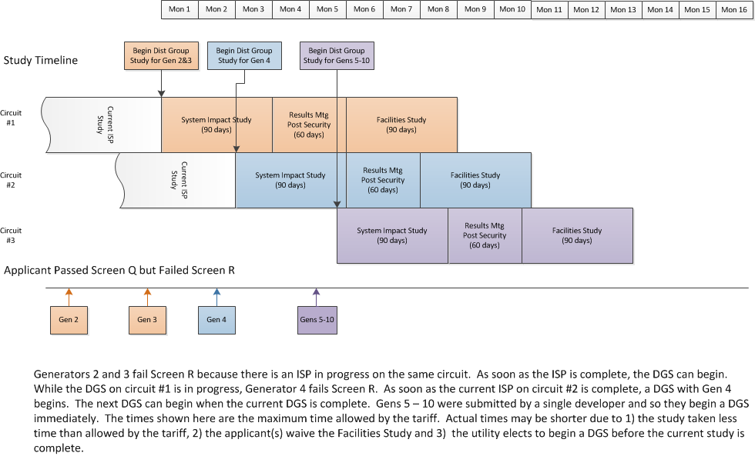
Example - Multiple Generators Connecting to Different Circuits

Slide 5
Example - Multiple Generators Connecting to Same Circuit

Slide 6
Cost Allocation
Cost Sharing
Costs will be allocated to the group similar to cost allocation in the cluster study process
Upgrade costs will be allocated on a per MW basis to all generators triggering each specific upgrade, for upgrades triggered by a single generator, cost will be allocated 100% to that generator
Short circuit related upgrades will be allocated based on the short circuit duty contribution of each generating facility
When any generator in the group drops out, the costs will allocated to the remaining generators
Restudies will be done (at Applicant’s cost) any time there is a change in circumstances that may result in a change to the upgrades required to interconnect a generator (e.g. generators from the distribution group drop out, an earlier-queued gen drops out, a planned upgrade is cancelled or delayed).
Impact on ISP
ISP remains unchanged and applies to generators that pass Screen Q and R.

Slide 7
WDAT and Electrical Area
Interaction with WDAT
WDAT generators that apply while a Rule 21 distribution group study is ongoing will fail the ISP independence test under the current tariff and will need to reapply or be studied under the cluster
WDAT generators that qualify for an ISP will be studied accordingly. Any Rule 21 generators that come while a WDAT study in a given electrical area is in progress, will be put into a distribution group study which will begin when the current study is complete or when there is sufficient information about the impact of earlier-queued projects
SCE reserves the right to modify its WDAT to include a distribution group study, but makes no commitment to do so
Definition of Electrical Area Requires Flexibility
Projects that fail Screen R will be placed into groups based on the electrical area of the point of interconnection
An electrical area will in some cases be the circuit and in other cases be the substation, but in any event, will be determined by engineering judgment.
Questions?

